Slide 1
Indian Travelling Guide
Industrial Training project……

Slide 2
Introduction

Slide 3
Objective..
This project aims to detect and identify Human Faces and describe a working, real time face recognition system which tracks a subject’s head and then recognizes the person by comparing characteristics of the face to those of known individuals.

Slide 4
Motivation..
As we are moving towards Digital world ,so there is a significant increase in Electronic transactions , hence there is a great demand for fast and accurate User identification and authentication but it brings security concerns too , for example an unauthorize user access ATM card, So in this case, Face recognition Technology solve this problem wisely since a face is undeniably connected to its owner.

Slide 5
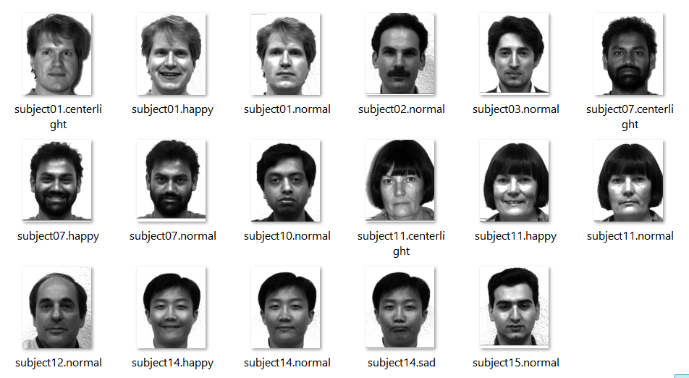
Datasets…
The dataset are used here is a Collection of Images of different persons with various expressions that will be considered for the Face recognition process.

Slide 6
Expected Algorithm used..
We will use a popular approach to face recognition called Eigenfaces. The essence of eigenfaces is an unsupervised dimensionality reduction algorithm called Principal Components Analysis (PCA) that we will use to reduce the dimensionality of images into something smaller.

Slide 7
Outcome…
After implementing face recognition face system using Eigenface method in python, we conclude that it will work efficiently on our testcases(images) and we get highly accurate results.
We have also concluded that it is fast ,secure and has work well in constrained environment.

Slide 8
Applications…
Used by security forces in counter terrorism.
Used in residential security.
Used in electronic devices like Smartphones, laptops for user identification.
Used in biometrics like Aadhar card, PAN card etc.

Slide 9
Thank
You…

